Slide 1
Basic Electrical Engineering (BEEE101L)
By
Dr. Maddela Chinna Obaiah
Assistant Professor (Sr)
School of Electrical Engineering

Slide 2
Module 3 Magnetic Circuits
Electromagnetic Induction: Self and mutual
Magnetically coupled circuits
Series and parallel magnetic circuits
Dot convention

Slide 3
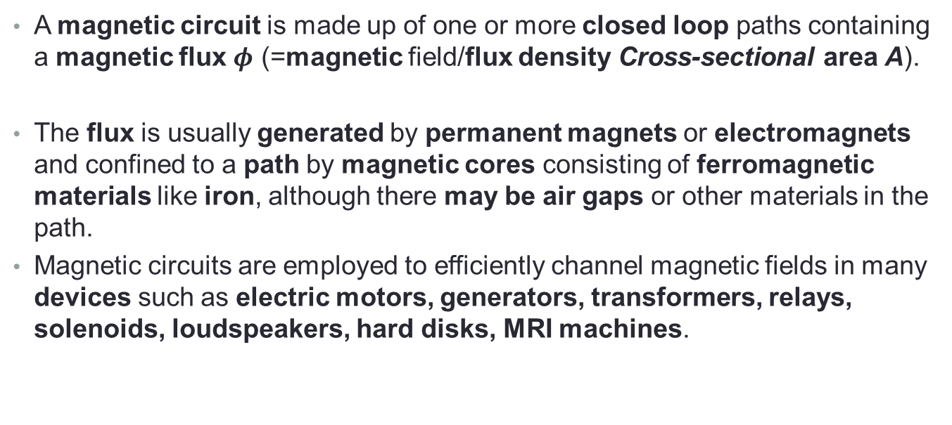
Introduction
A magnetic circuit is made up of one or more closed loop paths containing a magnetic flux $φ$ (=magnetic field/flux density Cross-sectional area A).
The flux is usually generated by permanent magnets or electromagnets and confined to a path by magnetic cores consisting of ferromagnetic materials like iron, although there may be air gaps or other materials in the path.
Magnetic circuits are employed to efficiently channel magnetic fields in many devices such as electric motors, generators, transformers, relays, solenoids, loudspeakers, hard disks, MRI machines.

Slide 4
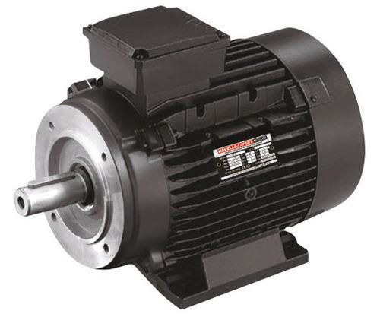
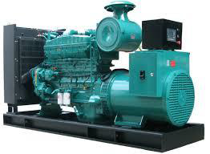
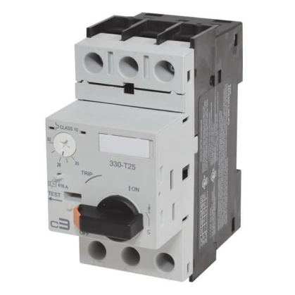
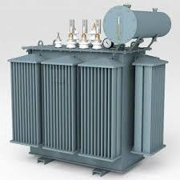
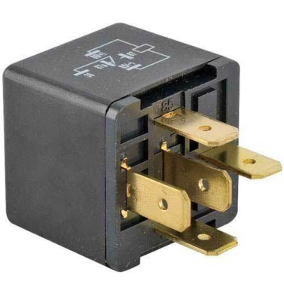
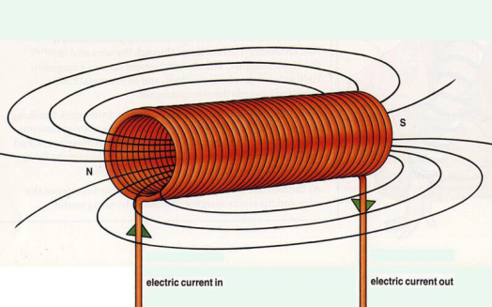
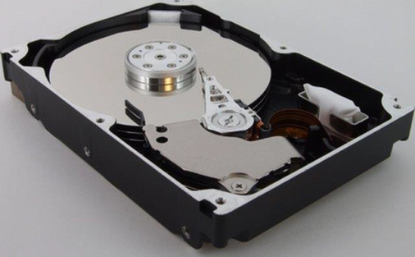
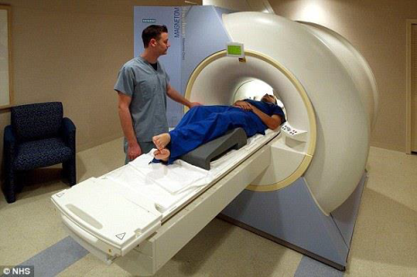
APPLICATIONS
Motors
Generators
Transformers
Circuit Breakers
Relay Switches
Solenoids
Hard Disks
MRI Machines

Slide 5
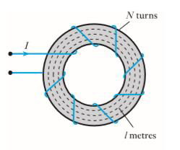
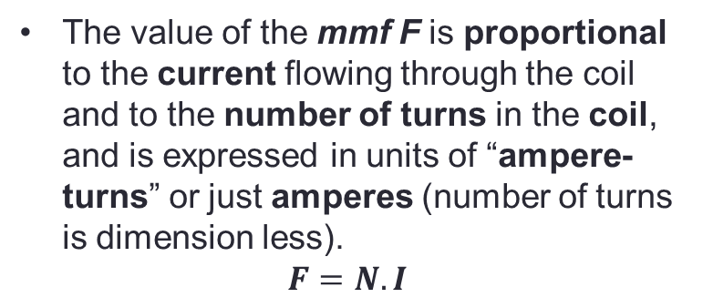
Magneto motive force (mmf)
In an electric circuit, the current is induced due to the existence of an electromotive force (emf E, battery voltage). By analogy, we say that in a magnetic circuit the magnetic flux is induced due to the existence of a magneto motive force (mmf F) caused by a current flowing through one or more turns of coil.
The value of the mmf F is proportional to the current flowing through the coil and to the number of turns in the coil, and is expressed in units of “ampere-turns” or just amperes (number of turns is dimension less).
$$F=N.I$$

Slide 6
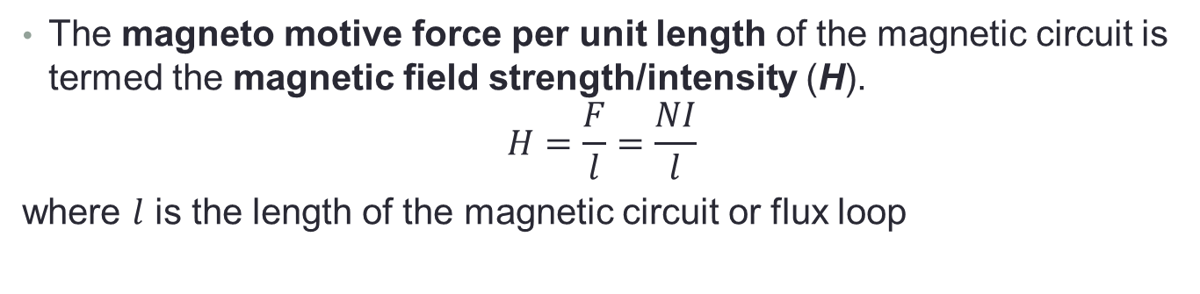
Magnetic field strength/intensity (H)
The magneto motive force per unit length of the magnetic circuit is termed the magnetic field strength/intensity (H).
$$H=\frac{F}{l}=\frac{NI}{l}$$
where $l$ is the length of the magnetic circuit or flux loop
Units of H are ampere-turns per meter (At/m) or just ampere per meter (A/m)

Slide 7
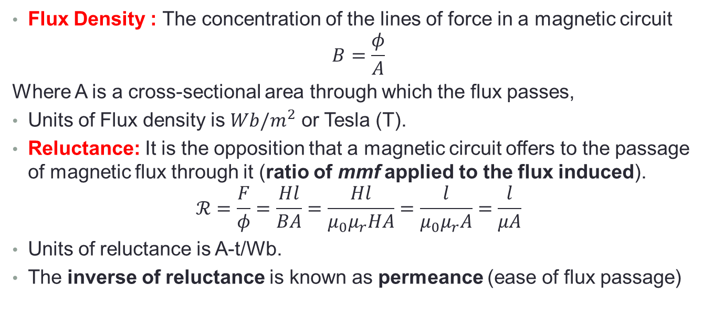
Flux Density and Reluctance
Flux Density : The concentration of the lines of force in a magnetic circuit
$$B=\frac{φ}{A}$$
Where A is a cross-sectional area through which the flux passes,
Units of Flux density is $Wb/m^{2}$ or Tesla (T).
Reluctance: It is the opposition that a magnetic circuit offers to the passage of magnetic flux through it (ratio of mmf applied to the flux induced).
$$ℛ=\frac{F}{φ}=\frac{Hl}{BA}=\frac{Hl}{μ_{0}μ_{r}HA}=\frac{l}{μ_{0}μ_{r}A}=\frac{l}{μA}$$
Units of reluctance is A-t/Wb.
The inverse of reluctance is known as permeance (ease of flux passage)

Slide 8
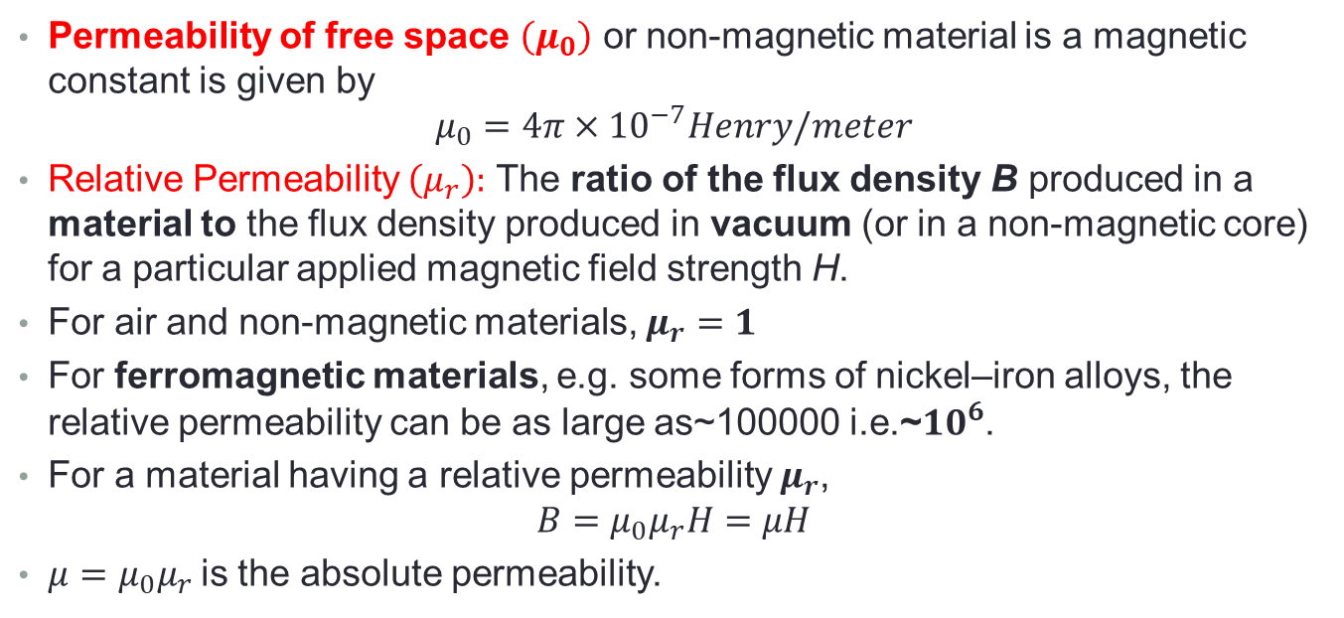
Permeability
Permeability of free space $\left(μ_{0}\right)$ or non-magnetic material is a magnetic constant is given by
$$μ_{0}=4π×{10}^{−7}Henry/meter$$
Relative Permeability $\left(μ_{r}\right):$ The ratio of the flux density B produced in a material to the flux density produced in vacuum (or in a non-magnetic core) for a particular applied magnetic field strength H.
For air and non-magnetic materials, $μ_{r}=1$
For ferromagnetic materials, e.g. some forms of nickel–iron alloys, the relative permeability can be as large as~100000 i.e.~${10}^{6}$.
For a material having a relative permeability $μ_{r}$,
$$B=μ_{0}μ_{r}H=μH$$
$μ=μ_{0}μ_{r}$is the absolute permeability.

Slide 9
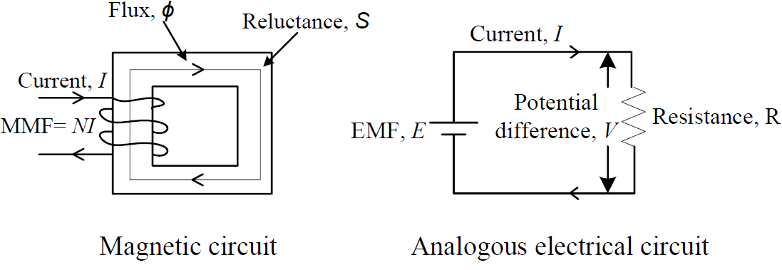
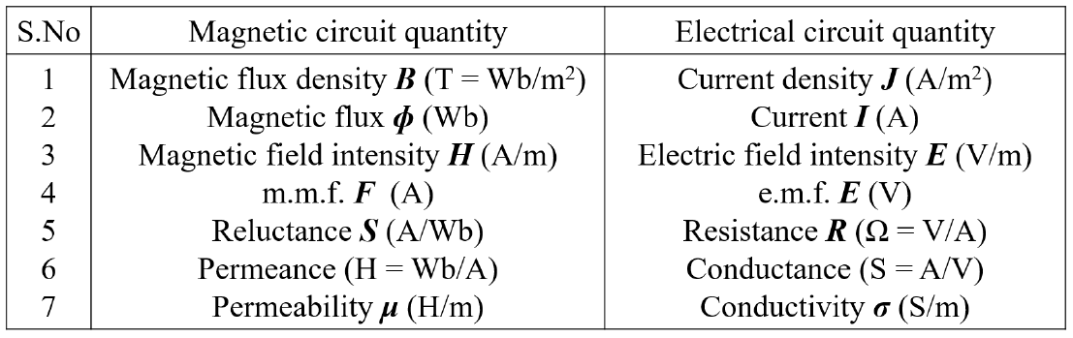
Magnetic Circuit Analogy With Electrical Circuit

Slide 10
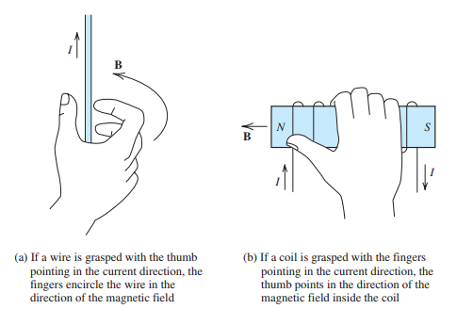
Right-Hand Rule : The direction of the magnetic field produced by a current can be determined by the right-hand rule.

Slide 11
Magnetically coupled Circuits
The circuits we have considered so far may be regarded as conductively coupled, because one loop affects the neighboring loop through current conduction.
When two loops with or without contacts between them affect each other through the magnetic field generated by one of them, they are said to be magnetically coupled.
The transformer is an electrical device designed on the basis of the concept of magnetic coupling.
It uses magnetically coupled coils to transfer energy from one circuit to another. They are used in power systems for stepping up or stepping down ac voltages or currents.
They are used in electronic circuits such as radio and television receivers for such purposes as impedance matching, isolating one part of a circuit from another, and again for stepping up or down ac voltages and currents.

Slide 12
Mutual inductance
When two inductors (or coils) are in a close proximity to each other, the magnetic flux caused by current in one coil links with the other coil, thereby inducing voltage in the latter.
This phenomenon is known as mutual inductance.

Slide 13
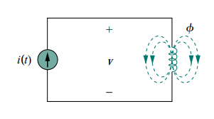
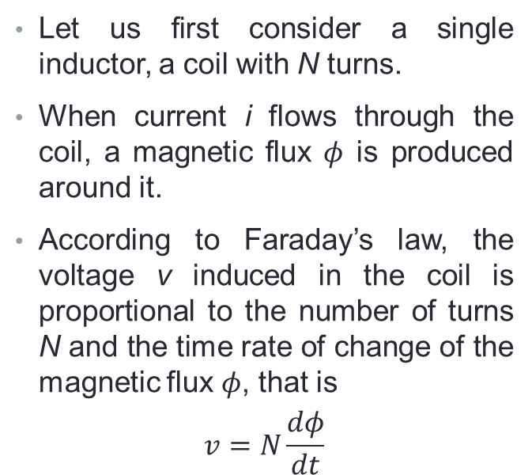
Self inductance
Let us first consider a single inductor, a coil with N turns.
When current i flows through the coil, a magnetic flux $φ$ is produced around it.
According to Faraday’s law, the voltage v induced in the coil is proportional to the number of turns N and the time rate of change of the magnetic flux $φ$, that is
$$v=N\frac{dφ}{dt}$$

Slide 14
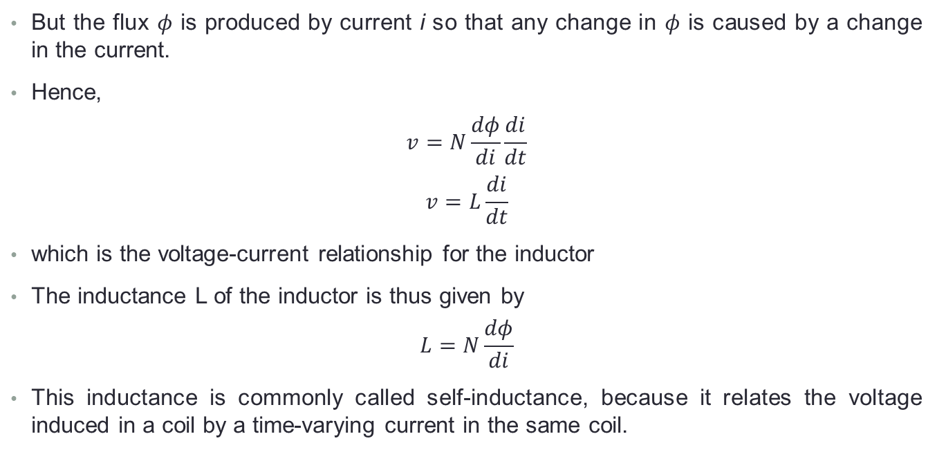
Self inductance
But the flux $φ$ is produced by current i so that any change in $φ$ is caused by a change in the current.
Hence,
$$v=N\frac{dφ}{di}\frac{di}{dt}$$
$$v=L\frac{di}{dt}$$
which is the voltage-current relationship for the inductor
The inductance L of the inductor is thus given by
$$L=N\frac{dφ}{di}$$
This inductance is commonly called self-inductance, because it relates the voltage induced in a coil by a time-varying current in the same coil.

Slide 15
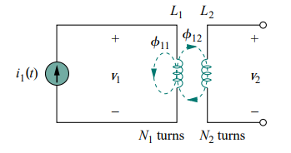
Mutual inductance
Now consider two coils with self-inductances L1 and L2 that are in close proximity with each other.
Coil 1 has N1 turns, while coil 2 has N2 turns.
The magnetic flux φ1 emanating from coil 1 has two components: one component φ11 links only coil 1, and another component φ12 links both coils.
Hence,
φ1 = φ11 + φ12

Slide 16
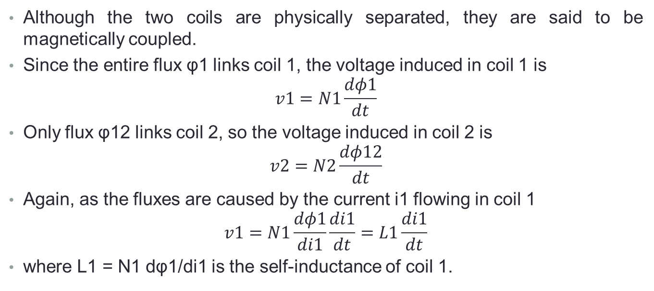
Mutual inductance
Although the two coils are physically separated, they are said to be magnetically coupled.
Since the entire flux φ1 links coil 1, the voltage induced in coil 1 is
$$v1=N1\frac{dφ1}{dt}$$
Only flux φ12 links coil 2, so the voltage induced in coil 2 is
$$v2=N2\frac{dφ12}{dt}$$
Again, as the fluxes are caused by the current i1 flowing in coil 1
$$v1=N1\frac{dφ1}{di1}\frac{di1}{dt}=L1\frac{di1}{dt}$$
where L1 = N1 dφ1/di1 is the self-inductance of coil 1.

Slide 17
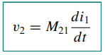
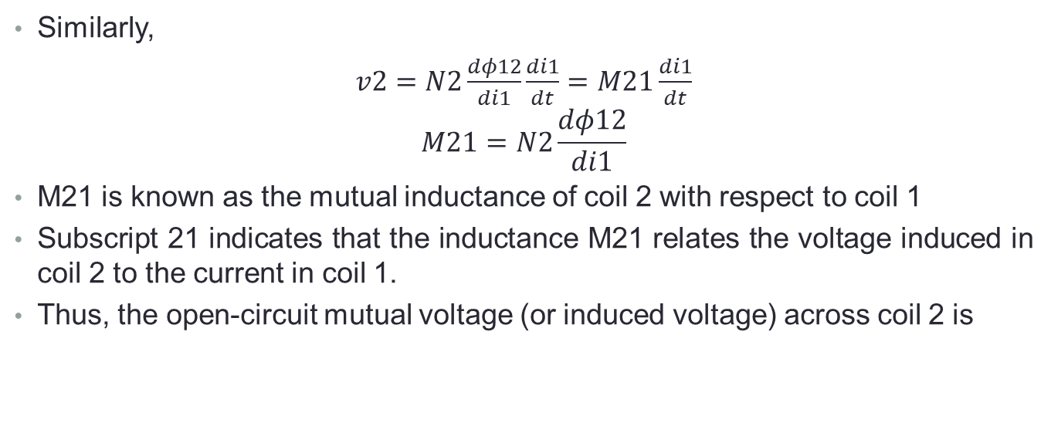
Mutual inductance
Similarly,
$v2=N2\frac{dφ12}{di1}\frac{di1}{dt}=M21\frac{di1}{dt}$
$$M21=N2\frac{dφ12}{di1}$$
M21 is known as the mutual inductance of coil 2 with respect to coil 1
Subscript 21 indicates that the inductance M21 relates the voltage induced in coil 2 to the current in coil 1.
Thus, the open-circuit mutual voltage (or induced voltage) across coil 2 is

Slide 18
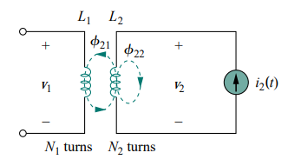
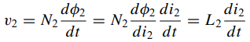
Mutual inductance
Suppose we now let current i2 flow in coil 2, while coil 1 carries no current
The magnetic flux φ2 emanating from coil 2 comprises flux φ22 that links only coil 2 and flux φ21 that links both coils.
φ2 = φ21 + φ22
The entire flux φ2 links coil 2, so the voltage induced in coil 2 is

Slide 19
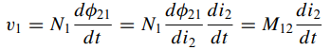
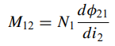
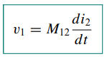
Mutual inductance
where L2 = N2 dφ2/di2 is the self-inductance of coil 2.
Since only flux φ21 links coil 1, the voltage induced in coil 1 is
Where
which is the mutual inductance of coil 1 with respect to coil 2.
Thus, the open-circuit mutual voltage across coil 1 is

